Slide 1

New Pig Trail Hog Website
HOG[SCAN]
www.pigtrailhog.com

Slide 2
New Website Look (www.pigtrailhog.com)

Slide 3

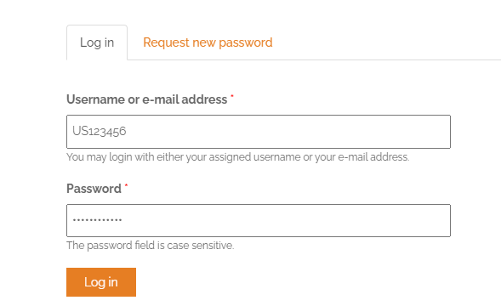
How to Login
Click “Login” Link
Default Username is HOG National Member Number (unless changed)
Password: Changed at Account Creation

Slide 4

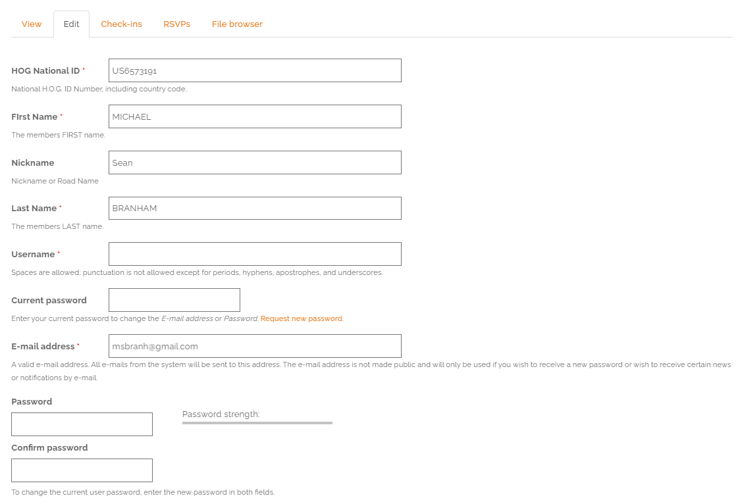
Change Username
Log into Website
Click My Account, then edit
Type new Username
Type in current password
Type in new Password
Retype new password to confirm
Click Save at the bottom of the page

Slide 5
Updating Account Info
We ask the following fields get updated your profile:
Username
Address
Email Address
Phone Number
Emergency Contact Name and Phone Number
Photo Upload
Bio (Optional)

Slide 6

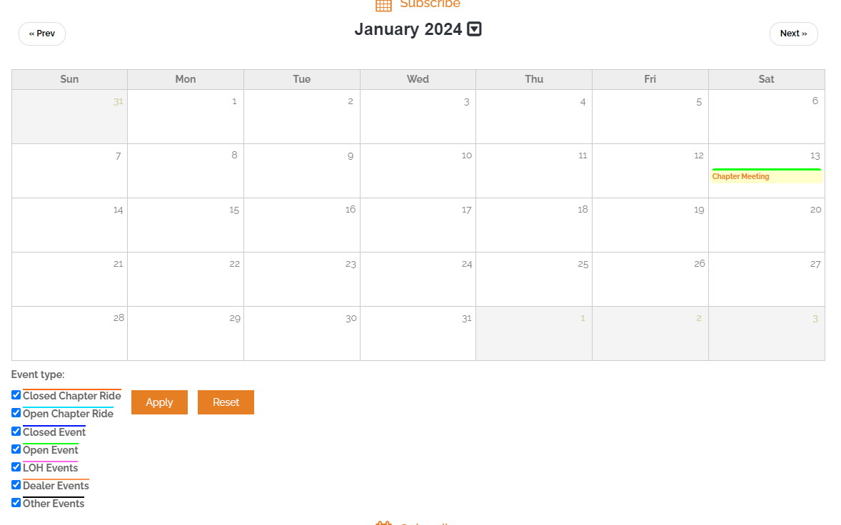
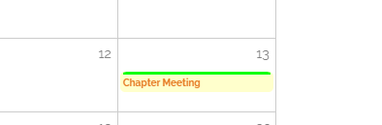


Event RSVP (RSVP and UnRSVP)
Click to RSVP
Click to UnRSVP
(if unable to attend after already RSVP)

Slide 7
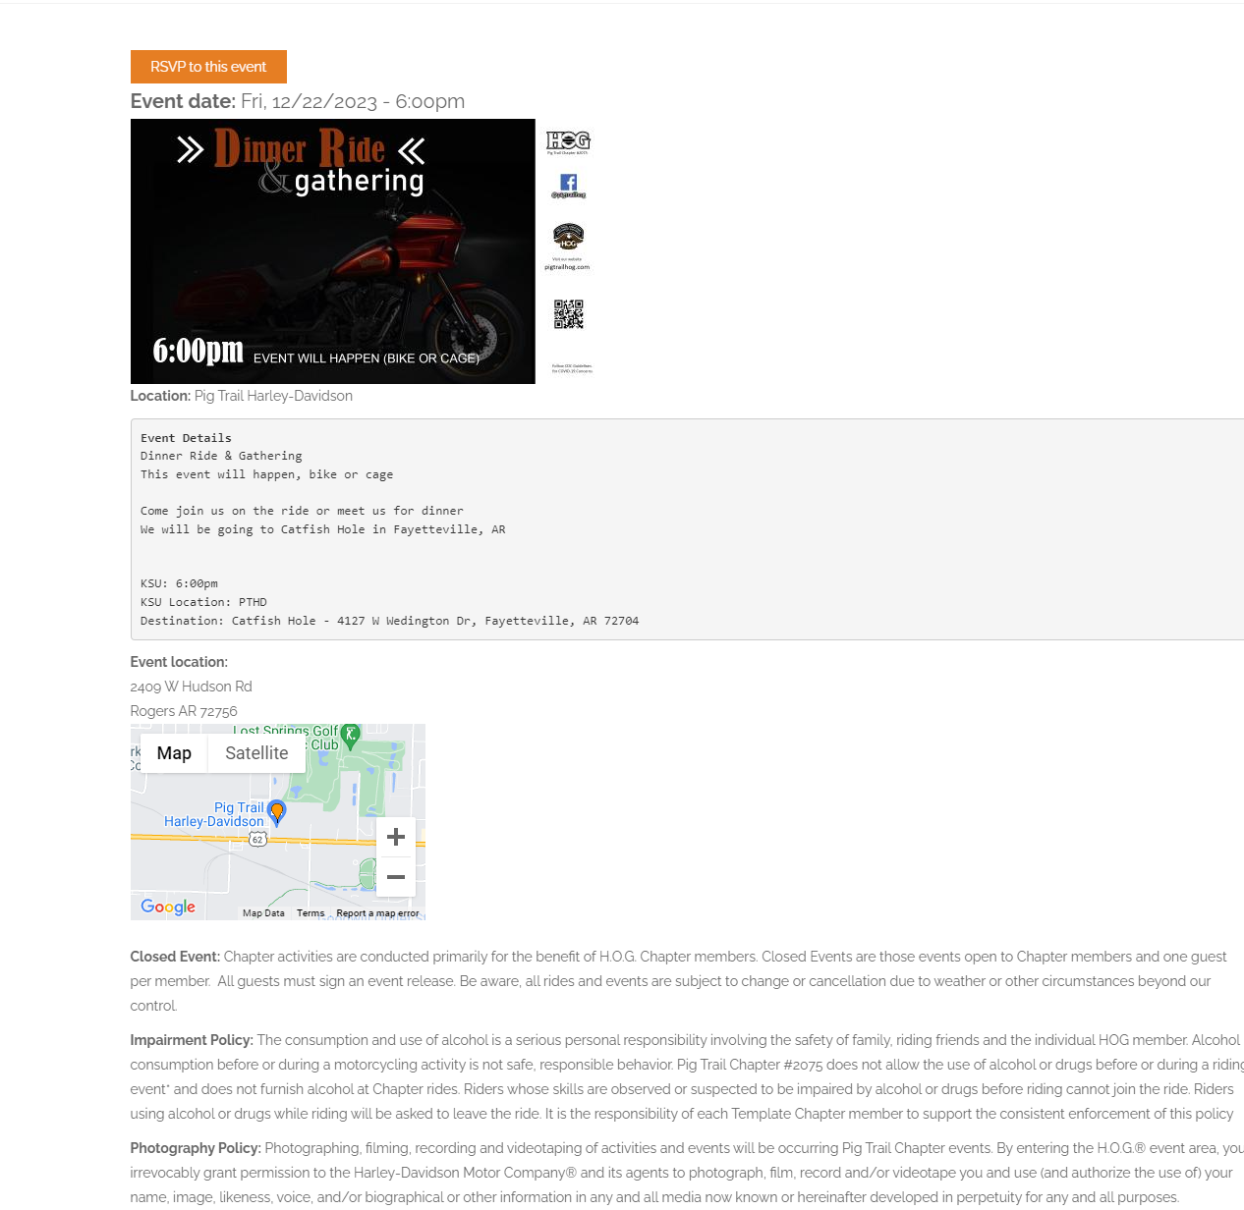
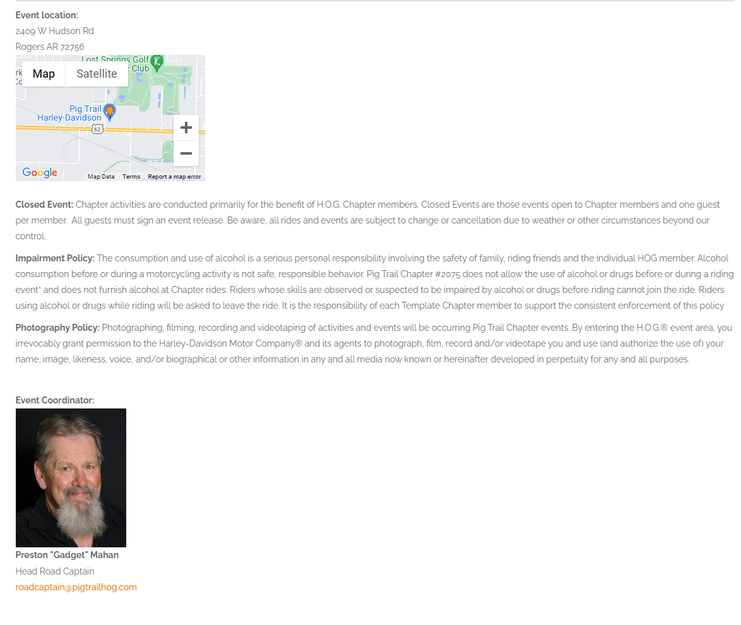
Event Details

Slide 8
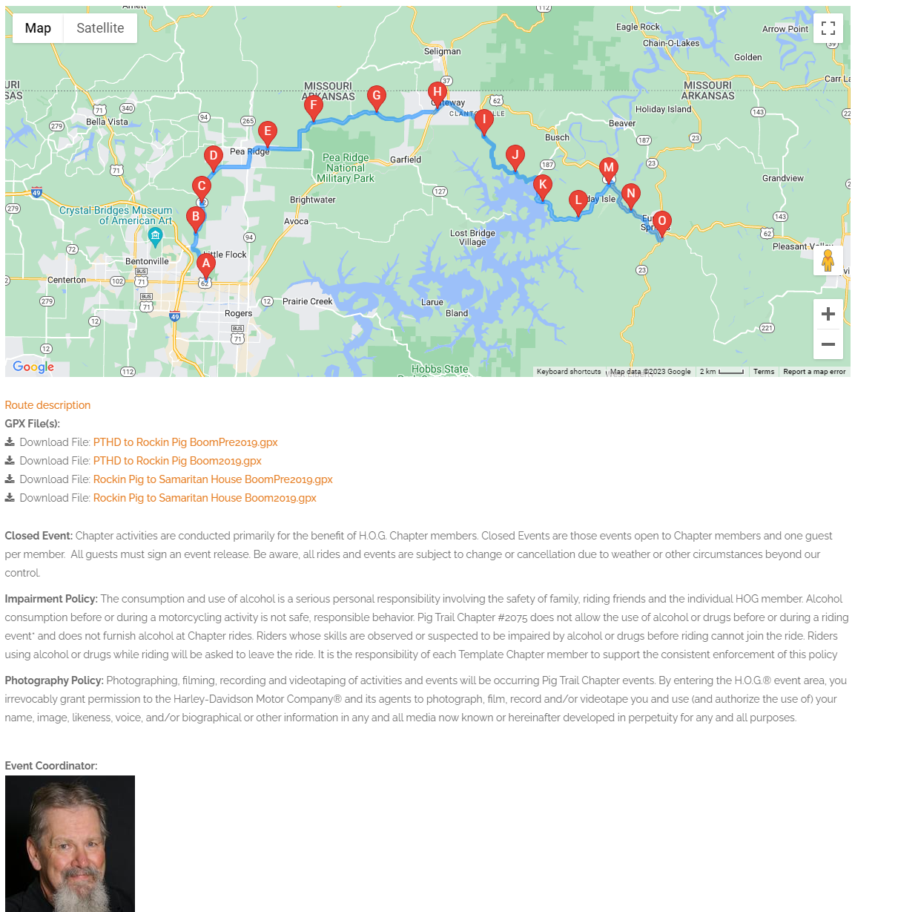
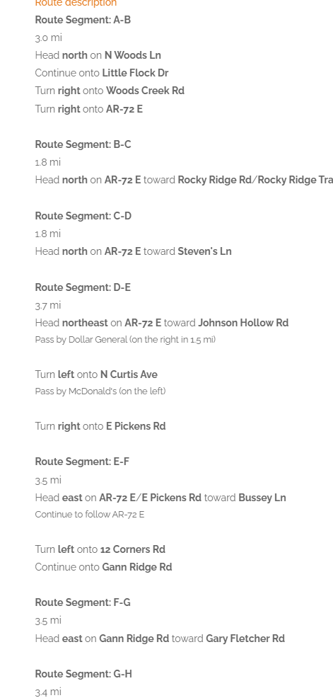
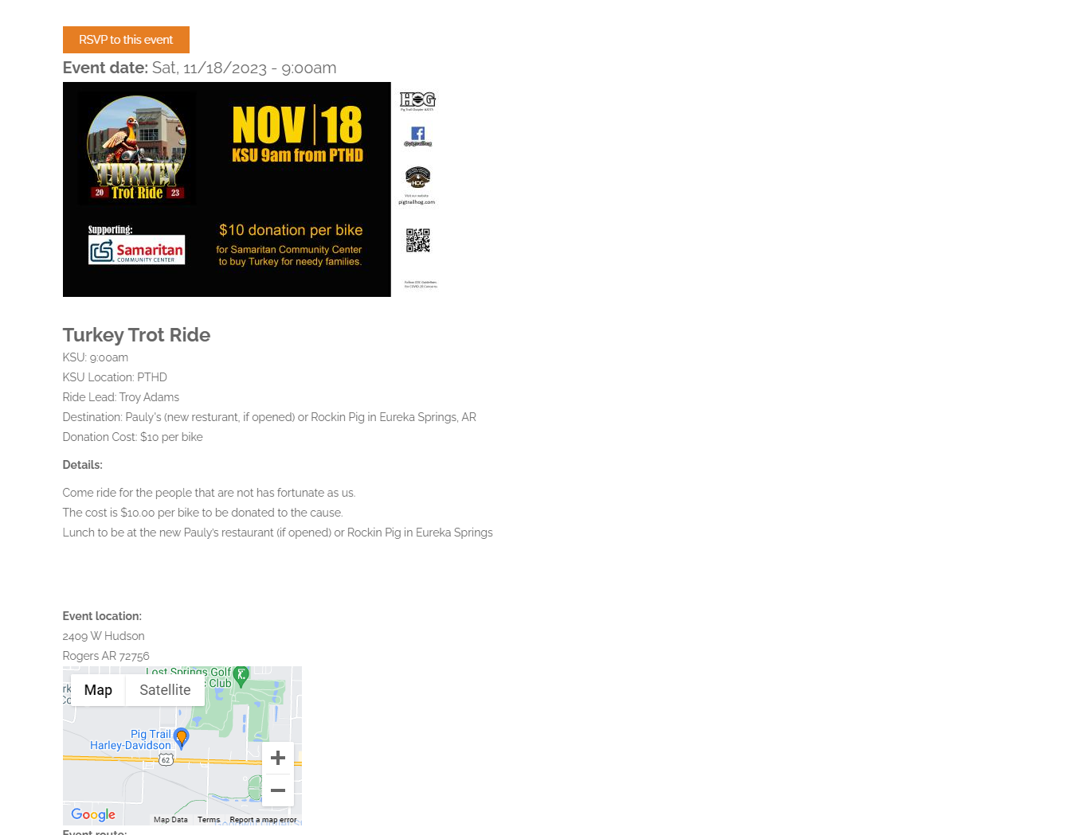
Events with GPX

Slide 9
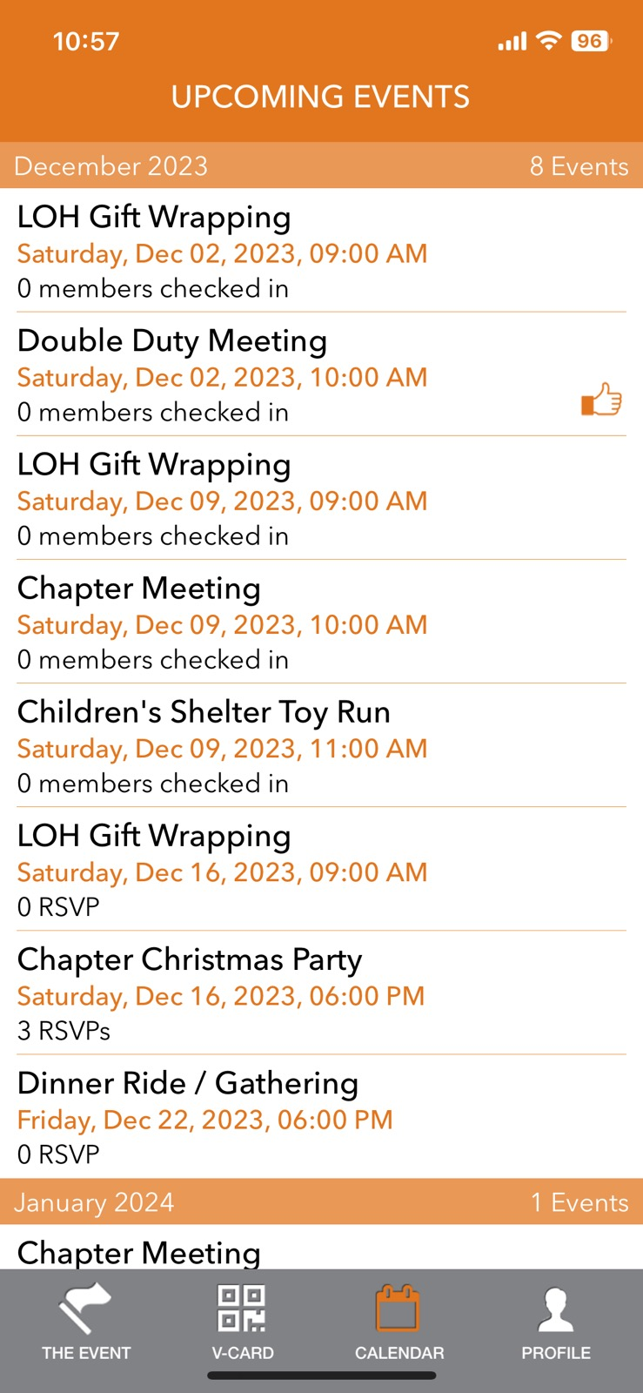
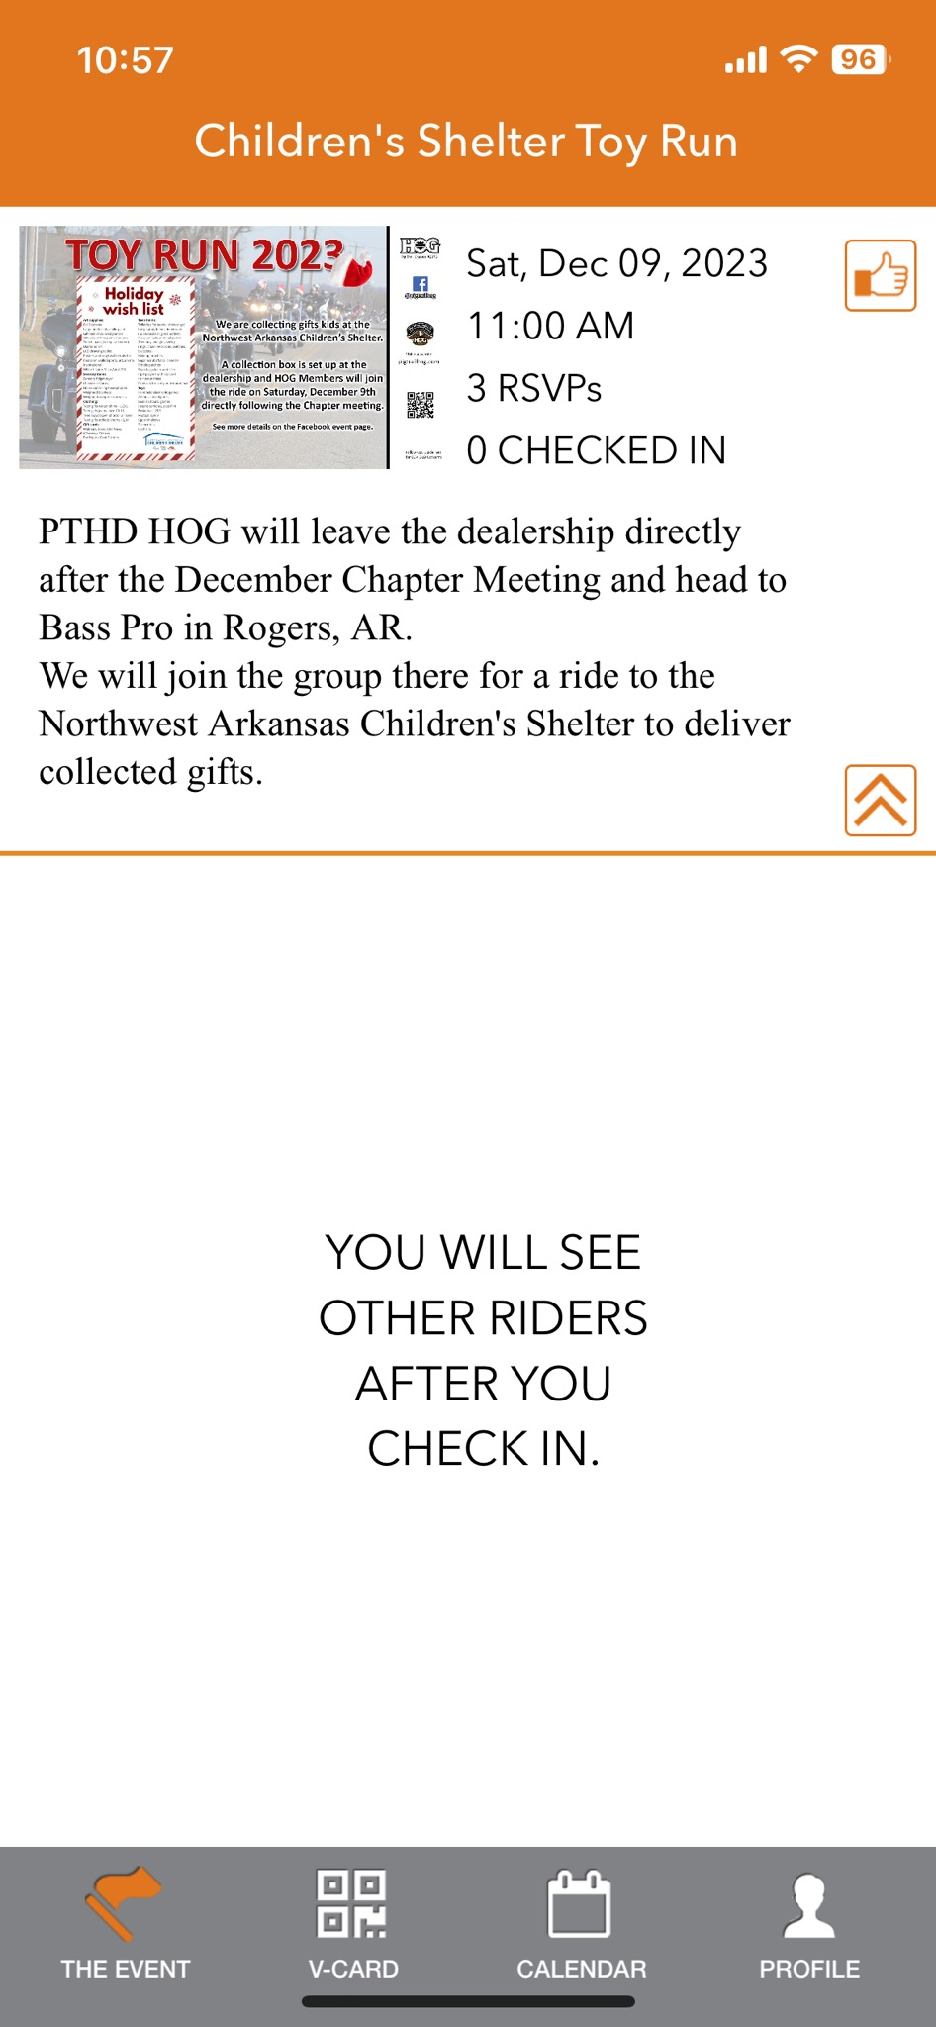
App RSVP

Slide 10
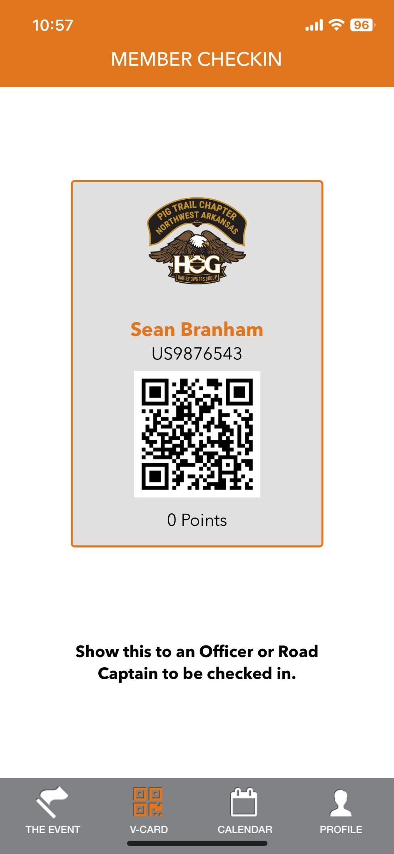
Event Check-in
Two Methods: App (Preferred) and Manual Check-In
App - Ride Lead, Officer, Event Coordinator will scan your Virtual Card QR Code from your app
Manual - Ride Lead, Officer, Event Coordinator will have to check you in using your name
This will verify your National and Local Memberships are updated. Expired memberships will require a release to be signed

